Slide 1
Embedding the learning from SAR’s
Jane Wells & Derek Tracy Director of Nursing , Clinical Director
July 2019

Slide 2
Learning from SAR’s
Any newly published SAR’s are presented at the next quarterly trust SGA committee
Monitoring of SAR actions is through a Borough spreadsheet , reviewed at SGA committee quarterly
New SAR page on the intranet – includes links to published SAR’s
Information about SAR’s is Included in our face to face level 3 SGA training

Slide 3
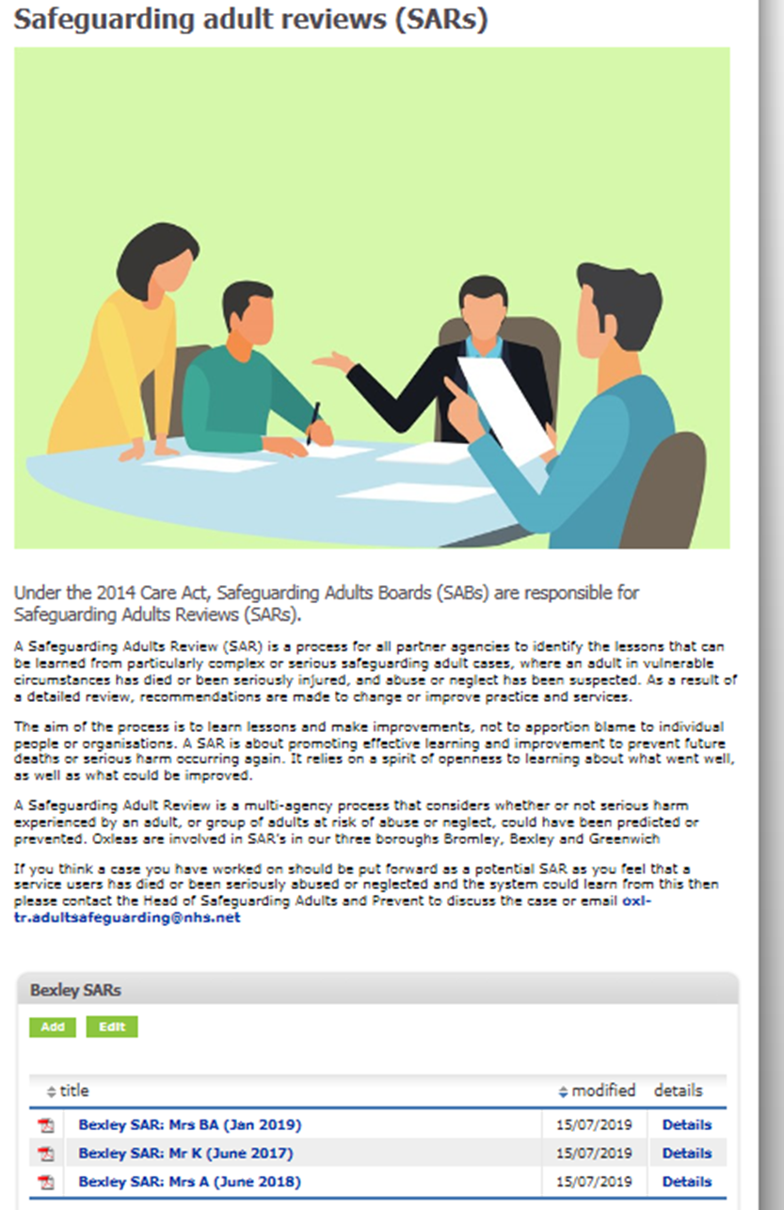

Slide 4
Governance of SAR’s
Internally
SGA committee
Locally through patient safety groups – Bexley PSG
Information available on intranet
Externally
SAR sub group
Actions fed back to SAB

Slide 5
Mrs BA actions
FINDING 4 -
Joint Training Programme for Mental Health Professionals and NRPF Team on the Immigration and Appeals Process | BSAB to organise MH and NRPF Teams to have immigration and appeals process training and to ensure that details of Immigration SOCS are available on the BSAB website | BSAB Bexley MH and NRPF Team | 01/10/2019 | Staff from Oxleas attended joint training in June with NRPF team
Review current arrangements to improve joint working and responsibility for delivering support, including communication to this group between NRPF Team and Mental Health Services. | MH and NRPF Teams to feedback to Sub Group on what communication pathways exist and show evidence of its effectiveness. | Bexley MH and NRPF Teams | 01/10/2019 | awaiting confirmation of how this will be evidenced

Slide 6
Mrs BA actions
FINDING 5 -
Ensure Mental Health Crisis Line is accessible and available 24 hours a day | BSAB MH partners to share their details with BSAB for sharing on website after reviewing accessibility to the numbers and evidence that the public know how to use it. | MH Partners | 01/07/2019 | Mental Health Urgent Advice Line: 0800 330 8590 (24 hour service) http://oxleas.nhs.uk/advice-and-guidance/how-to-get-help/

Slide 7
Thank you

