Slide 1
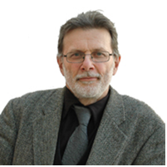
Independent Chair of the Safeguarding Adults Board
Professor Michael Preston-Shoot, Professor Emeritus (Social Work)
Having worked as an Education Welfare Officer, Michael completed a Postgraduate Diploma in Social Work and the Certificate of Qualification in Social Work. He undertook various social work roles before he became a social work academic in 1988.
During his time in social work he undertook the Postgraduate Diploma in Psychotherapy at Leeds University, and later achieved a PhD from Liverpool John Moores University.
Michael joined the University of Bedfordshire in 2003, initially as Head of Department of Applied Social Studies. He was Executive Dean of the Faculty of Health and Social Sciences between 2005 and 2016. Michael specialised in teaching law to non-lawyers, principally social workers and social work students, but also enjoyed teaching research skills, working with groups and working systemically with families.
Michael is the current Independent Chair of both Lewisham Safeguarding Adults Board & Brent Safeguarding Adults Board. He was Independent Chair of Luton Local Safeguarding Children Board between 2009 and 2015 and Luton Safeguarding Adults Board between 2008 and 2015.
Michael has authored and researched serious case reviews and safeguarding adult reviews.
One of his areas of expertise is self-neglect and hoarding.

